Slide 1




.NET Conf 2023 - Ukraine
Vladislav Antonyuk
Rostyslav Skrypnik

Slide 2
World Explorer – uncovering the World with Every Step!
AI-Powered Exploration
Comprehensive Place Descriptions
Nearby Recommendations
Personalized Experience

Slide 3

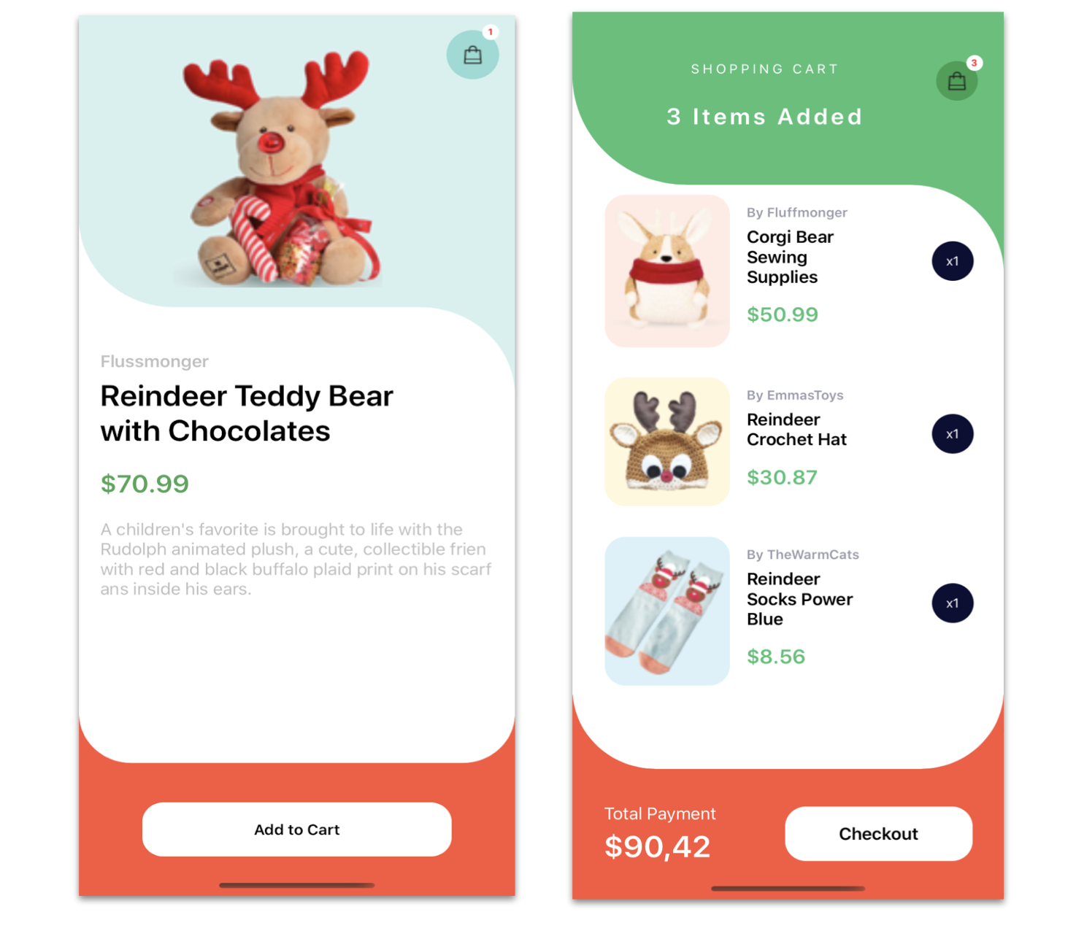
Xamarin
Xamarin Forms Good-looking UI - https://github.com/jsuarezruiz/xamarin-forms-goodlooking-UI
Applications in Production - https://gist.github.com/davidortinau/5c9129e2bfaabafcb58df07325cb4a90

Slide 4




Slide 5

.NET MAUI
A single project for different platforms
A single place to manage all resources
Full support for Hot Reload
Productivity

Slide 6

Azure AD Microsoft Entra ID

Slide 7
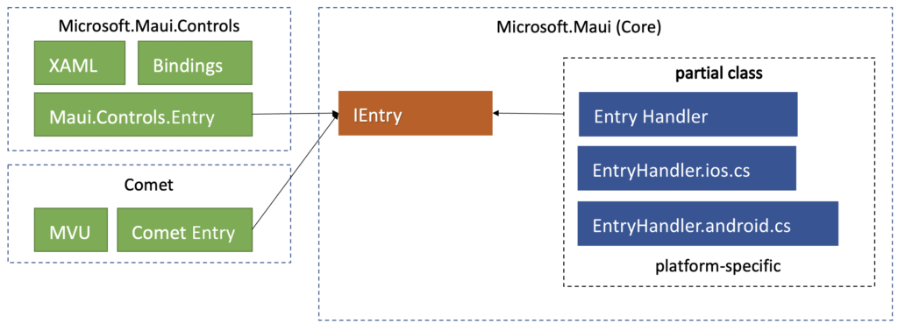
.NET MAUI Handler architecture

Slide 8
.NET MAUI Handler sample

Slide 9


Slide 10
Blazor app

Slide 11
Build rich interactive web UI with Blazor
Fully integrated with ASP.NET Core
Powerful reusable component model
Easily handle UI events
Built-in components for form and validation
Write C#, interop with JS as needed

Slide 12
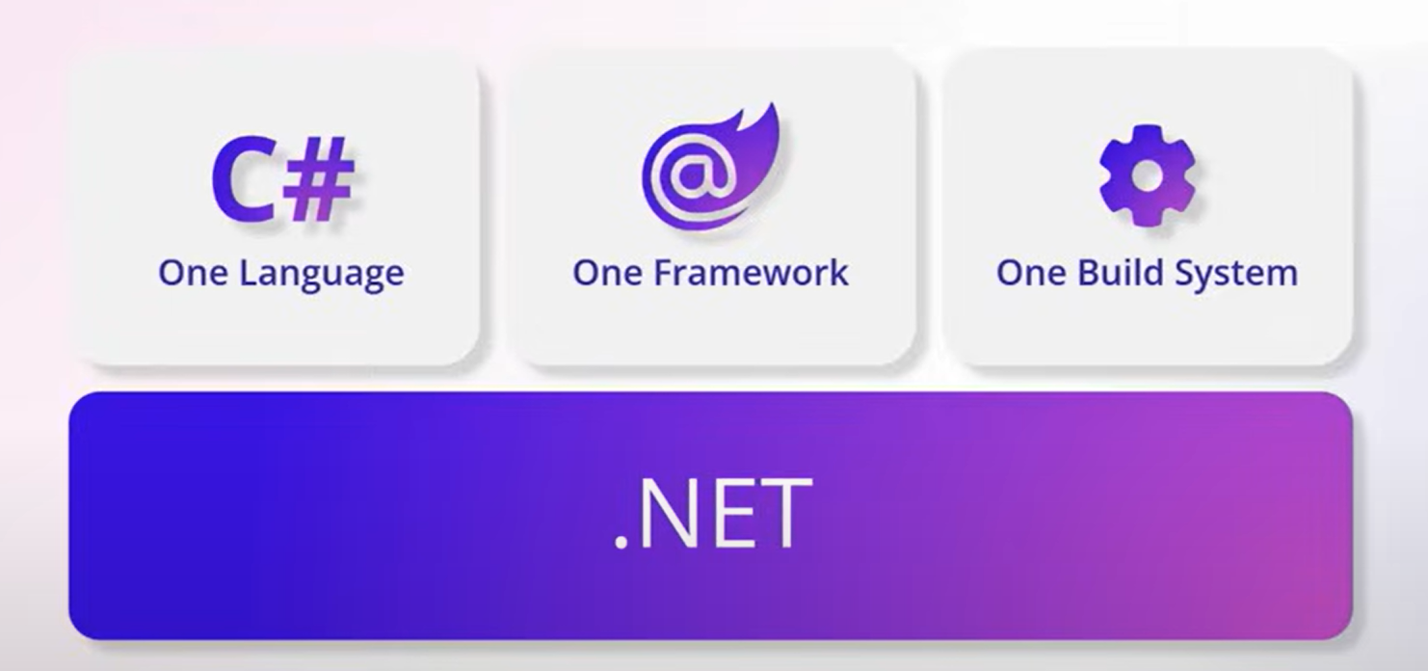
Build web apps faster with Blazor

Slide 13
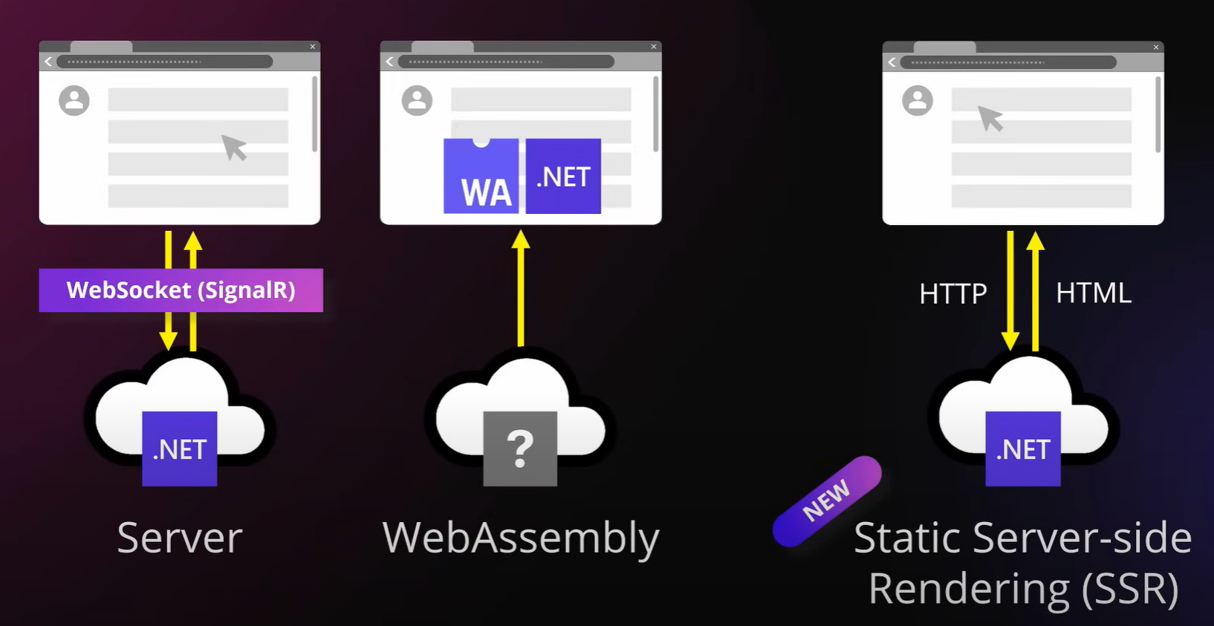
Full stack web UI With Blazor

Slide 14

.NET MAUI + Blazor = Hybrid app
https://learn.microsoft.com/en-us/aspnet/core/blazor/hybrid/tutorials/maui?view=aspnetcore-7.0

Slide 15
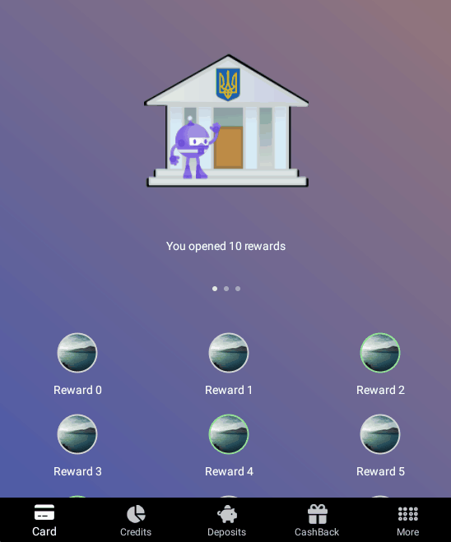
.NET MAUI features
Animations (Fade, Tada)
Pages (ContentPage, FlyoutPage, TabbedPage...)
Layouts (Grid, VerticalStackLayout)
Controls (Button, Label, Slider, Popup*, DrawingView*)
Behaviors (Email Validation – doesn’t require platform implementation)
Converters (EnumToIntConverter)
And much more...

Slide 16
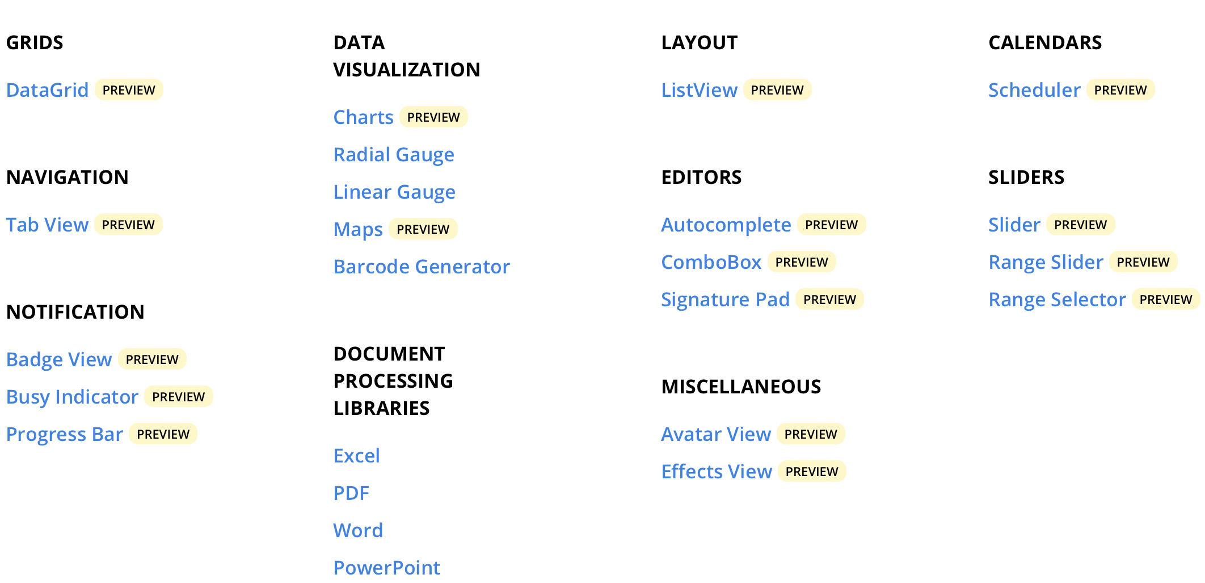
Syncfusion Controls for .NET MAUI

Slide 17
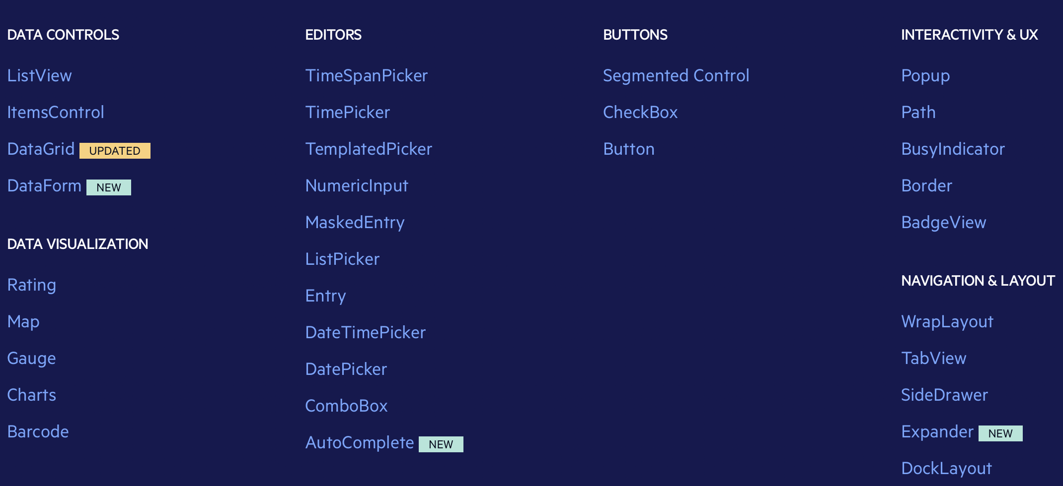
Telerik UI for .NET MAUI

Slide 18
.NET MAUI Community Toolkit
Alerts
Snackbar
Toast
Animations
FadeAnimation
Essentials
AppTheme Resources
Badge
FolderPicker
FileSaver
SpeechToText
Views
AvatarView
DrawingView
Expander
LazyView
MediaElement
Popup
SemanticOrderView
Converters
Behaviors
AnimationBehavior
CharactersValidationBehavior
EmailValidationBehavior
EventToCommandBehavior
IconTintColorBehavior
MaskedBehavior
MaxLengthReachedBehavior
MultiValidationBehavior
NumericValidationBehavior
ProgressBarAnimationBehavior
RequiredStringValidationBehavior
SetFocusOnEntryCompletedBehavior
StatusBarBehavior
TextValidationBehavior
UriValidationBehavior
UserStoppedTypingBehavior
ImageSources
GravatarImageSource
Extensions
ColorAnimationExtensions
ColorConversionExtensions
KeyboardExtensions
SemanticOrderView
ServiceCollectionExtensions
Layouts
DockLayout
StateContainer
UniformItemsLayout
C# Markup

Slide 19
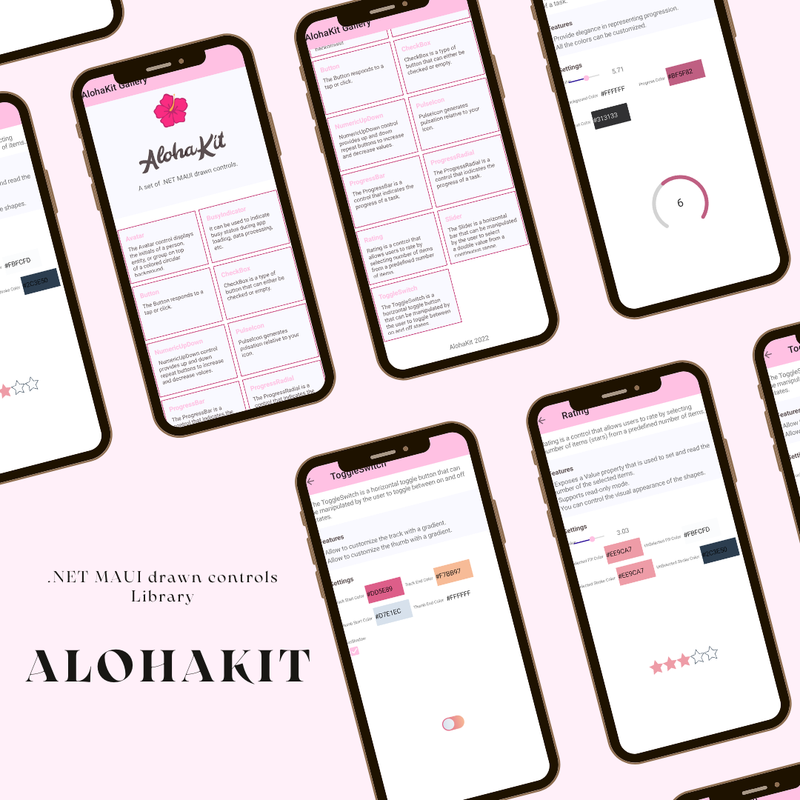
.NET MAUI drawn controls
https://github.com/jsuarezruiz/AlohaKit

Slide 20
.NET MAUI
https://github.com/jsuarezruiz/dotnet-maui-showcase
https://snppts.dev/
https://dotnet.microsoft.com/en-us/platform/customers/maui

Slide 21

Links and Samples
World Explorer
.NET MAUI docs
.NET MAUI repo
The first project with .NET MAUI
CommunityToolkit.Maui
MauiSamples
Gerald Versluis YouTube
James Montemagno YouTube

